Slide 1
eVal Implementation
TEACHER EXPERIENCE
May 27, 2015

Slide 2
Home
Log Out
eVal
for
Professional Growth & Evaluation
Tasks
Learning
My eVal Account
For setting up for mobile app; could also have Help info for OSPI portal and, if you are principal, reminder of eVal roles of HP, Building Admin
Welcome Donna Schmidt
District: Seattle Public Schools
School: Daniel Boone Elementary
Evaluator: John Doe
Evaluation Cycle: Focused
Area of focus: C1; SG-C3
eVal Role: Teacher

Slide 3
Home/ Professional Growth & Evaluation Tasks
Workflow
Evidence
Your Alerts
Help
2014-2015
Log Out
Workflow Overview
Use this section to complete your self assessment, set goals and, at the end of the year, review your Summative Evaluation report.
See your District’s procedures for which of these are required for you.
At the end of the year, or if you are leaving the District, you can use the Extract All feature to download all of your information.
Self Assessment
Goal Setting
Summative Evaluation
Extract All

Slide 4
Home/ Professional Growth & Evaluation Tasks
Workflow
Evidence
Your Alerts
Help
2014-2015
Log Out
Workflow Overview
TBD
Self Assessment
Goal Setting
Summative Evaluation
Extract All

Slide 5
Home/ Professional Growth & Evaluation Tasks
Workflow
Evidence
Your Alerts
Help
2014-2015
Log Out
This breadcrumb remains on all pages even though it’s not shown on all pages in this deck.
Workflow Overview
TBD
Self Assessment
Goal Setting
Summative Evaluation
Extract All

Slide 6
Workflow
Evidence
Your Alerts
Help
2014-2015
Log Out
The Summative Evaluation report contains summative scores provided by your evaluator based on evidence collected throughout the year.
The Summative Evaluation is not hand drafted by the evaluator as much as it is a compilation of information that you and your evalutor have entered into eVal over the course of the year. The evaluator will select which information to include and may also include their own summative statement for each criteria. Also, any reflection you add will automatically appear on the report (be sure to add it before the report is finalized).
The report defaults to a status of “Draft.” That status will change as the evaluator moves it through its workflow, making it available for you to review at your evaluation conference and again once the report has been finalized after the conference.
After the report has been finalized, you will have the opportunity to add any final comments you may have.
Workflow Overview
Self Assessment
Goal Setting
Summative Evaluation
Overview
Your Reflections
View Report
Extract All

Slide 7
Workflow
Evidence
Your Alerts
Help
2014-2015
Log Out
Workflow Overview
Self Assessment
Goal Setting
Summative Evaluation
Same as existing Reflections panel
Overview
Your Reflections
View Report
Extract All

Slide 8
Workflow
Evidence
Your Alerts
Help
2014-2015
Log Out
Workflow Overview
Self Assessment
Goal Setting
Summative Evaluation
Same as existing panel – need to make it more clear when the report has been actually submitted.
The “Teacher Response” menu item would only appear after they view the final report – or, this isn’t a menu item at all… but somehow we need to give them the opportunity to either confirm they don’t have a response (which wil submit right away) or enter a response (and then it wil submit) or, after X days, it will submit…)
Overview
Your Reflections
View Report
Teacher Response
Extract All

Slide 9
Workflow
Evidence
Your Alerts
Help
2014-2015
Log Out
Workflow Overview
Self Assessment
Goal Setting
Summative Evaluation
Same as existing panel
Overview
Your Reflections
View Report
Teacher Response
Extract All

Slide 10
Workflow
Evidence
Your Alerts
Help
2014-2015
Add column for “Ad-hoc or nonobserveable” with check box like for evaluator
Log Out
Claim Statements
Uploaded Items
Observations
Evidence Overview
Dashboard
C1
Centering instruction on high expectations for student achievement.
Details
View Rubric
2b. Establish a culture for learning
The classroom culture is a cognitively busy place where learning is valued by all, with high expectations for learning being the norm for most students.
Kindergarten lesson plan
Playground photo
2014-2015.1 2014-2015.2
Manage Artifacts
Observations
3a: Communicating with Students
The teacher clearly communicates instructional purpose of the lesson, including where it is situated within broader learning, and explains procedures and directions clearly.
Spanish lesson plan
AP group activity
2014-2015.2 2014-2015.3
3c: Engaging students in learning
Students may have some choice in how they complete tasks and may serve as Your Alerts for one another.
Student video
3rd grade Wiki
2014-2015.4 2014-2015.5
Items in Red signify activity from your evaluator. Click on the item to view details. Click on Help to clear the alert.

Slide 11
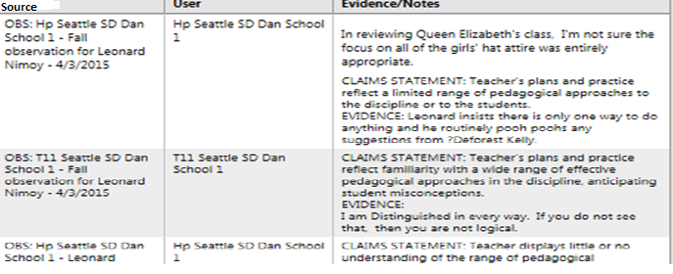
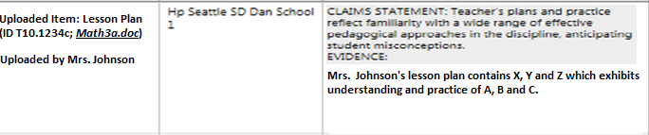
Workflow
Evidence
Your Alerts
Help
2014-2015
Log Out
Evidence Overview
Dashboard
Details
View Rubric
Manage Artifacts
Observations
Legend:
During Observation
Outside of observation
Uploaded Item
Evaluator

Slide 12
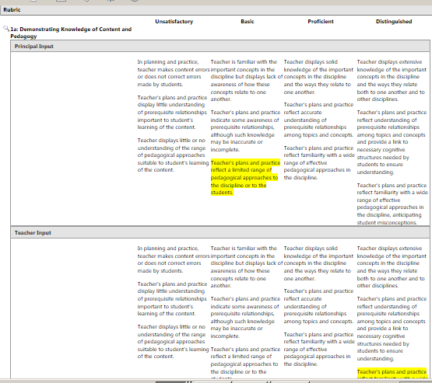
Workflow
Evidence
Your Alerts
Help
2014-2015
Log Out
Evidence Overview
Dashboard
Details
View Rubric
Manage Artifacts
Observations

Slide 13
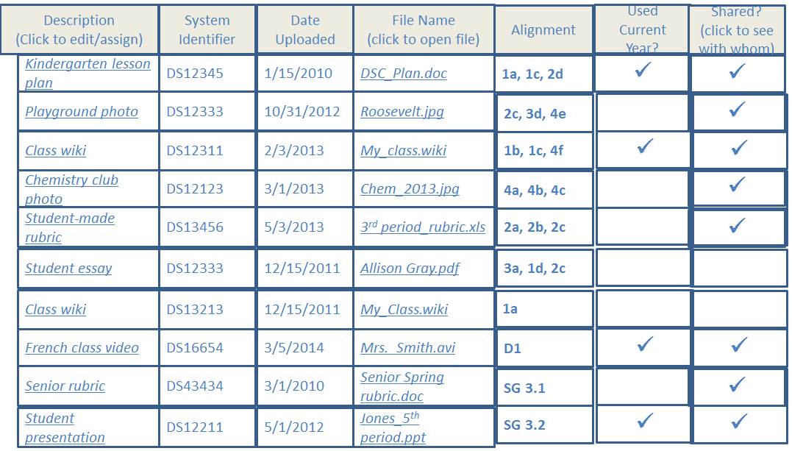
Workflow
Evidence
Your Alerts
Help
2014-2015
Log Out
If only shows for one year, need easy way to switch years and copy forward. Also, teacher should toggle back and forth to see ones they entered and ones the evaluator entered.
Evidence Overview
Dashboard
Manage Artifacts
Find and Sort
View (Reader)
Edit/Code
Upload New
Delete
Observations
Download List
(Search and query controls could go here)

Slide 14
Workflow
Evidence
Your Alerts
Help
2014-2015
Log Out
Evidence Overview
Doc Title:
Date uploaded:
Uploaded by:
File Name:
Doc Desc:
Doc Context:
Alignment:
Attached to observations (this school year): ______________
Has evaluator scored, added evidence to or attached to rubric this school year? (Y/N) [If yes, Date]
Dashboard
Manage Artifacts
(Viewer – displays content of uploaded item)
Find and Sort
View (Reader)
Edit/Code
Upload New
Delete
Observations
Open File
(Search and query controls could go here)

Slide 15
Workflow
Evidence
Your Alerts
Help
2014-2015
Log Out
Code
Edit
Evidence Overview
Dashboard
If user owns this item, then they can :
Change Item Name
Change Item Description
Add/change/remove from the observation it is attached to
Re-align Item to different (or additional) rubric component(s)
Manage Artifacts
Find and Sort
View (Reader)
Edit/Code
Upload New
Delete
Observations

Slide 16
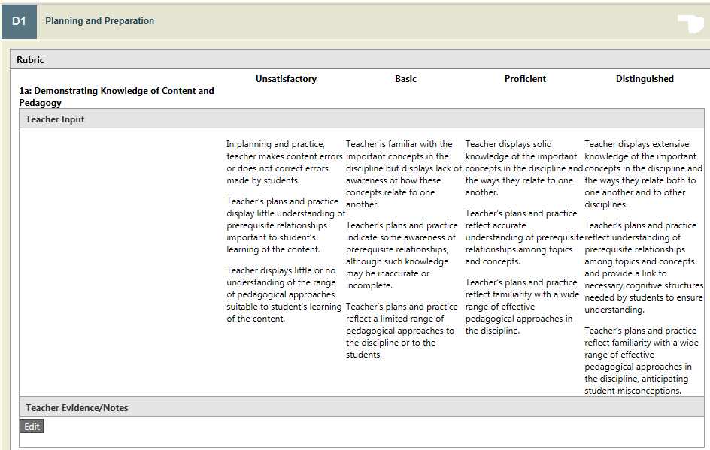
Workflow
Evidence
Your Alerts
Help
2014-2015
Log Out
Edit
Code
If user owns this item, then they can :
Change Item Name
Change Item Description
Add/change/remove from the observation it is attached to
Re-align Item to different (or additional) rubric component(s)
Evidence Overview
Dashboard
Manage Artifacts
Find and Sort
View (Reader)
Edit/Code
Upload New
Delete
Observations

Slide 17
Workflow
Evidence
Your Alerts
Help
2014-2015
Log Out
This form allows user to:
Load an item
Name the item
Add a description
Add a context
Align the item to a rubric component
Assign the item to an existing observation (if applicable)
Evidence Overview
Dashboard
Manage Artifacts
Find and Sort
View (Reader)
Edit/Code
Upload New
Delete
Observations
We are assuming that when the teacher wishes to add evidence, they are either adding (1) an uploaded item, or (2) entering text directly related to uploaded item and/or observation. [Does the teacher ever need to add written evidence that is NEITHER attached to an observation nor to an artifact????]

Slide 18
Workflow
Evidence
Your Alerts
Help
2014-2015
Log Out
Evidence Overview
This form allows user to delete an item if it has not yet been reviewed/coded by evaluator. (Do we need a workflow by which it is deleted with agreement from parties even if it has already been coded?)
Dashboard
Manage Artifacts
Find and Sort
View (Reader)
Edit/Code
Upload New
Delete
Observations

Slide 19
Workflow
Evidence
Your Alerts
Help
2014-2015
Log Out
Evidence Overview
Dashboard
OVERVIEW OF “OBSERVATIONS “ IN EVAL
eVal allows you to prepare for and respond to each phase of the observation process (depending on your District, you may or may not use all of the functionality).
As you and your evaluator add information into an observation, it immediately becomes available for viewing on the Observation tab and on the Observation Report.
When the observation activities are complete, your evaluator may lock the observation. This indicates that you have both entered any evidence and comments you wish to add and that you are now considering the Report as “final.” You may request to your evaluator that an observation be “unlocked” at any time (as may your evaluator request to you). Locking the observation ensures that the information you have received on the Observation Report cannot be changed without both you and your evaluator agreeing to it.
Information from a locked observation will now be available as selectable content on your Summative Evaluation.
To get started, click on a particular observation and then choose from the drop down box “Observation Workflow.” (If you do not see an observation listed, your evaluator may not yet have made it visible to you.)
Manage Artifacts
Observations
Overview
Formal
10/1/14
12/15/14
2/20/15
Walk-through
10/15/14
12/31/14
1/20/15
3/14/15

Slide 20
Workflow
Evidence
Your Alerts
Help
2014-2015
Log Out
Evidence Overview
Dashboard
Manage Artifacts
Observations
Pre Conf
Observation Session
Post Conf
Lock/Unlock
Report
Teacher Response
General Info
Overview
Formal
10/1/14
12/15/14
2/20/15
Walk-through
10/15/14
12/31/14
1/20/15
3/14/15

Slide 21
Workflow
Evidence
Your Alerts
Help
2014-2015
Log Out
Evidence Overview
(Drop down box)
Dashboard
Observation Workflow
Manage Artifacts
General Info
Observations
Overview
Formal
10/1/14
Observation Focus:
Pre-Conf Date:
Observation Date:
Post Conf Date:
Has Observation been locked?
Request Unlock (or grant unlock request)
12/15/14
2/20/15
Walk-through
10/15/14
12/31/14
1/20/15
3/14/15
Can we have a  or ✓ or some indicator for each drop-down category where the evaluator has updated info and the teacher should make sure to see?

Slide 22
Workflow
Evidence
Your Alerts
Help
2014-2015
Log Out
Evidence Overview
Observation Workflow
(Drop down box)
Dashboard
Pre Conference
Manage Artifacts
Observations
Evaluator Prompt:
Formal
10/1/14
12/15/14
2/20/15
Teacher Response:
Walk-through
10/15/14
12/31/14
1/20/15
(Several prompts may list here. )
3/14/15
Evaluator Comments:
Teacher Comments:

Slide 23
Workflow
Evidence
Your Alerts
Help
2014-2015
Log Out
Observation Workflow
(Drop down box)
Evidence Overview
Observation
Notes
Dashboard
Rubric & Evidence
Manage Artifacts
Observations
Formal
10/1/14
12/15/14
2/20/15
Walk-through
10/15/14
12/31/14
Assumes teacher does not need to use Notes Editor (though they may wish to click on Notes just to see what the evaluator has scripted) – their main interest is in the evidence gathered and how it has been aligned to the rubric
1/20/15
3/14/15

Slide 24
Workflow
Evidence
Your Alerts
Help
2014-2015
Log Out
Observation Workflow
(Drop down box)
Evidence Overview
Home
Post Conference
Evidence
Observations
Evaluator Prompt:
Formal
10/1/14
12/15/14
2/20/15
Teacher Response:
Walk-through
10/15/14
12/31/14
1/20/15
(Several prompts may list here. )
3/14/15
Evaluator Comments:
Teacher Comments:

Slide 25
Workflow
Evidence
Your Alerts
Help
2014-2015
Log Out
Home
Observation Workflow
(Drop down box)
Evidence
Lock/ Unlock
Observations
Formal
10/1/14
For the teacher, this will display whether the observation has been locked, date locked, and choice to request unlock.
12/15/14
2/20/15
Walk-through
10/15/14
12/31/14
1/20/15
3/14/15

Slide 26
Workflow
Evidence
Your Alerts
Help
2014-2015
Log Out
Home
Observation Workflow
(Drop down box)
Evidence
Report
Observations
Formal
10/1/14
12/15/14
2/20/15
Observation report prints to this screen; user has option to download as PDF
Walk-through
10/15/14
12/31/14
1/20/15
3/14/15

Slide 27
Workflow
Evidence
Your Alerts
Help
2014-2015
Log Out
Observation Workflow
Home
(Drop down box)
Teacher Response
Evidence
Observations
Now that the observation is concluded and you have reviewed the Report, would you like to add final comments that will become part of the Observation Report?
(In order for the evaluator to know that this observation is completed, including a final report with any response you wish to add, this option is available for ___ days. If you enter comments below and wish to edit them later, or if you wish to enter your comments after that time period, then you will need to request that the observation be unlocked.)
Formal
10/1/14
12/15/14
2/20/15
Walk-through
10/15/14
12/31/14
1/20/15
Teacher’s Response
3/14/15
Save
Save button needs a “Are you sure? If you wish to edit later, you will need to request that the Observation be unlocked.
If teacher has already entered their Response, then text above will be slightly different, saying the text has already been entered.
Once saved, this content is reflected on the Report

Slide 28
Workflow
Evidence
Your Alerts
Help
2014-2015
Log Out
1
2
3
Evidence flows to the Observation Report and, if selected, to the Summative Evaluation Report
Evidence is entered by you and by your evaluator
Evidence is coded and available for you to view
Evidence Overview
Dashboard
Manage Artifacts
Observations
You may upload artifacts related to a particular observation or as non-observable evidence (and your evaluator may do so as well)
Once you upload an artifact, your evaluator can “code” it, i.e., add evidence notes and rubric text (you may do that too)
OBSERVATION REPORTS
All information entered for a particular observation will show up on that report, including all evidence attached to that observation.
SUMMATIVE EVALUATION REPORT
The Summative Evaluation Report is a summation of your observations and other evidence entered throughout the year. If you have information you wish considered as part of a particular observation or artifact, make sure to add it as evidence to that observation or artifact!
Your evaluator enters notes and evidence during an observation (and you may do so as well)
All of the notes that the evaluator has coded to the rubric, and any quotes from the rubric, will show up on your Dashboard
Your evaluator may enter ad-hoc notes and evidence throughout the year that is not particularly tied to an observation
Any evidence entered will show up on your dashboard, regardless of the source (i.e., whether you entered it, or your evaluator, whether it was from an observation or related to an artifact, etc.

Slide 29
Workflow
Evidence
Your Alerts
Help
2014-2015
Log Out
Clear Alerts
Select | Date | Source | Activity | See Change
□ | 11/1/15 | Mary Poppins | Observation has been made visible to you | 2013-2014.1
□ | 11/1/15 | Mary Poppins | Pre-conf prompt assigned to you | 2013-2014.1/ pre conf
□ | 11/15/15 | Mary Poppins | Artifact C234 has been reviewed | Artifact C234
□ | 11/30/15 | Mary Poppins | Evidence has been added to observation | 2013-2014.1
□ | 12/15/15 | Mary Poppins | Observation has been locked | 2013-2014.1
□ | 12/15/15 | Mary Poppins | Evaluator requests unlock | 2013-2014.1
□ | 5/15/15 | Mary Poppins | Summative evaluation is ready for your receipt | Summative Eval
□ | 1/5/15 | eVal Team | Updates added to eVal. | Release Notes
These alerts are for your convenience. They should not replace active discussion between you and your evaluator so that you are both aware of actions that need to be taken.

Slide 30
Workflow
Evidence
Your Alerts
Help
2014-2015
Log Out
eVal User Guides
Support
Release Notes (what’s new in eVal)
This part still needs to be designed. User guide and Help can be District-specific (and Districts could elect to turn off the State-supplied ones). Help would include District’s support email.

Slide 31
APPENDIX

Slide 32
(Here is a starting list of the suggested alerts we’ll track and the verbiage to use. But we must keep this at only those items the teacher truly needs to know about -- otherwise, this becomes less useful overall.
Update | Text to appear on Alerts page | Links to
New observation | Observation has been made visible to you | Observation/ General Info tab
Pre or Post conf prompts assigned | Pre-conf (or post conf) prompt assigned to you | Observation/ Pre or Post Conf tab
Info added to observation session (notes, or evid or claim statement) | Evidence has been added to observation | Observation/ Session tab
Obs locked | Observation has been locked | Observation/ General Info
Unlock request | Evaluator requests unlock | Observation/ Lock
Artifact reviewed | Artifact C234 has been reviewed | Artifact C234
Summary report ready | Summative evaluation is ready for your receipt | Summative Eval
New features in eVal | Updates added to eVal | Release Notes

Slide 33
Use case questions –
Does teacher ever add evidence that is not related to either an artifact or an observation?
We know an artifact can get aligned to multile components of rubirc and can have multiple claim statements attached – but then does it get used in multiple ways, i.e., attached to many observations and also to self assessment and also to goal?
Just what are the artifacts teachers load, does it really just come down to lesson plans for some of the teachers?
Why would a teacher use the same artifact in two years?
When a teacher loads an artifact, they align it, then the evaluator adds evidence and rubric text. Question: can the evaluator change the alignment or add additional alignment? And also, what if the teacher aligns it 1A but the rubric text that the evaluator selects for that artifact is from a different part of the rubric?
When loading an artifact, the act of choosing an additional identifier is inadvertently augmenting the existing TPEP process – the process doesn’t need that identifier as that should be implied by the Rubric. By adding this choice, teachers are confused what to select and it doesn’t add to the process (because everything should tie to the rubric.
What if eVal doesn’t use the word “Claim Statement”?
Can we set up for the evaluator a way to see dummy teacher screen?
Nomenclature – Claim statement, “Walk through” or “informal obervation”

